Slide 1
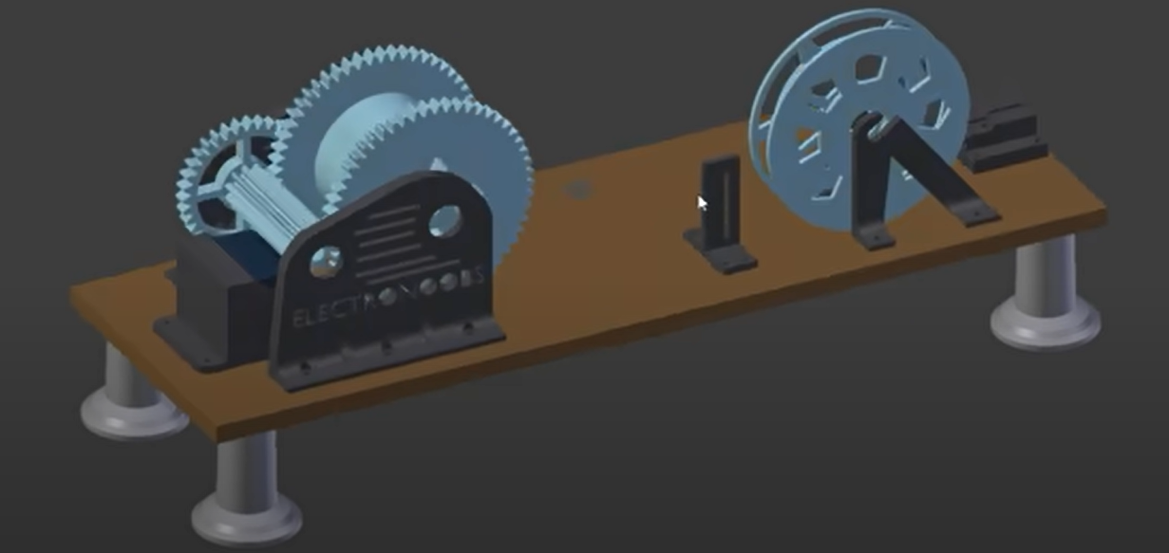

RAMBA FIBERS ltd
P r o j e c t : 3 D f i l a
Trash to Treasure

Slide 2
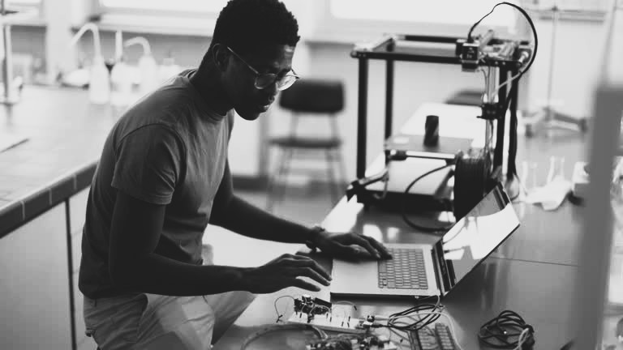

Would You Throw Away Your Treasure?
Meet Jules, a talented mechatronics engineer. He spends hours perfecting his designs, using at least three packs of 3D printing filament each month for prototypes and final products. But here’s the catch – every time Jules buys filament, he’s burning through an extra 50,000 FRW per pack.
3D fila
Hanga hubs/ Muhanga

Slide 3
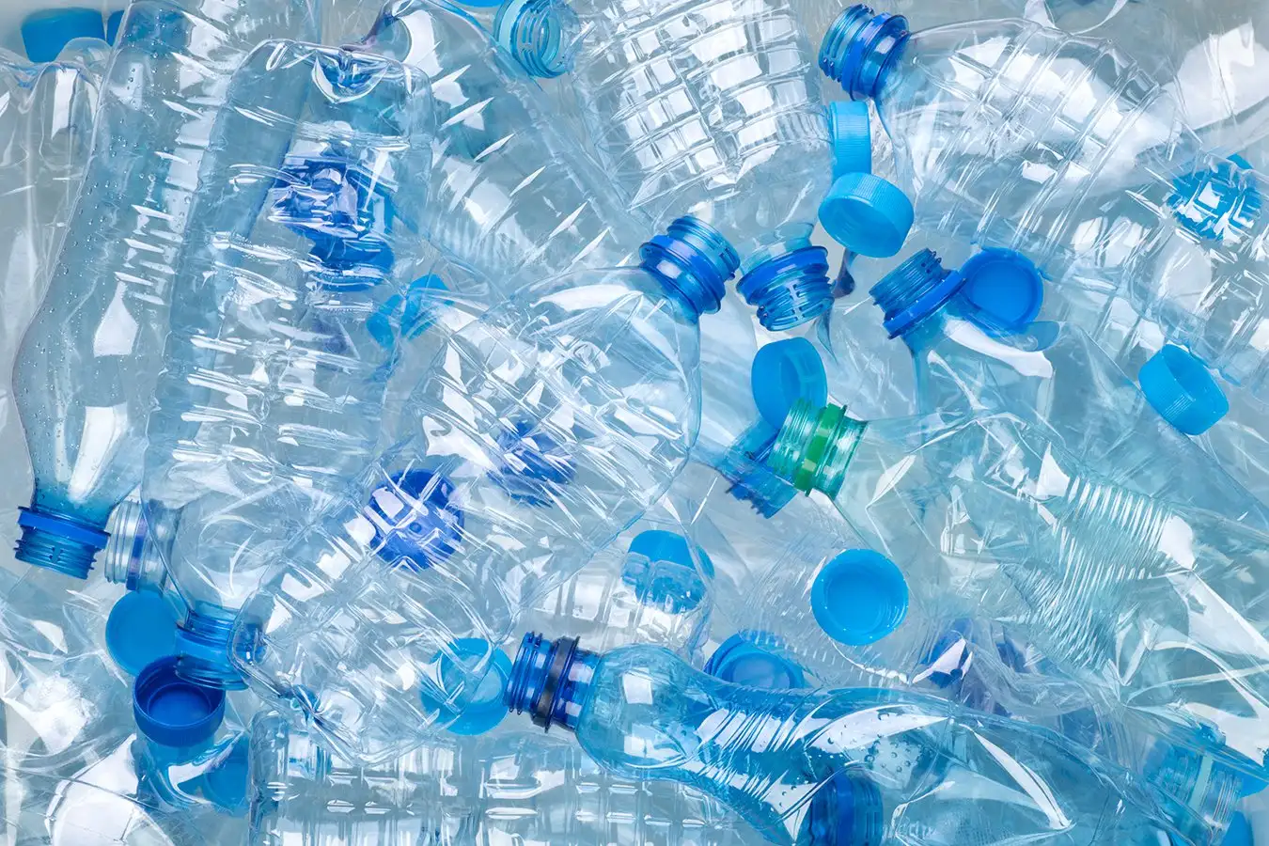

Problem
Problem 01
Problem 02
Despite the efforts being used plastic waste is still high with an estimation of 75,000 to 100,000 tones generated annually in the Rwanda, according to the world bank.
The high cost of 3D printing filaments remains a barrier, limiting innovation and accessibility for local businesses and entrepreneurs.
3D fila
Trash to Treasure

Slide 4
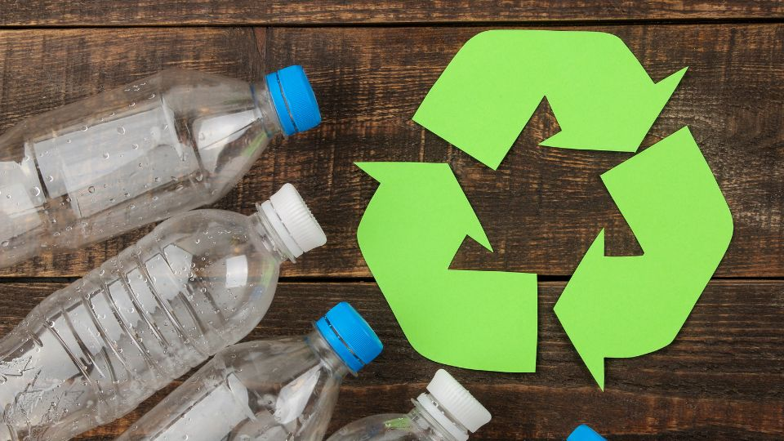
Solution
Solution 01
Solution 02
Reducing costs of 3D printing for businesses and manufacturers in Rwanda by using 3D printing filaments from recycled PET bottles.
Providing a viable alternative to traditional plastic waste recycling and disposal by making a 3D fila machine which recyle single use plastic bottles
3D fila
Trash to Treasure

Slide 5
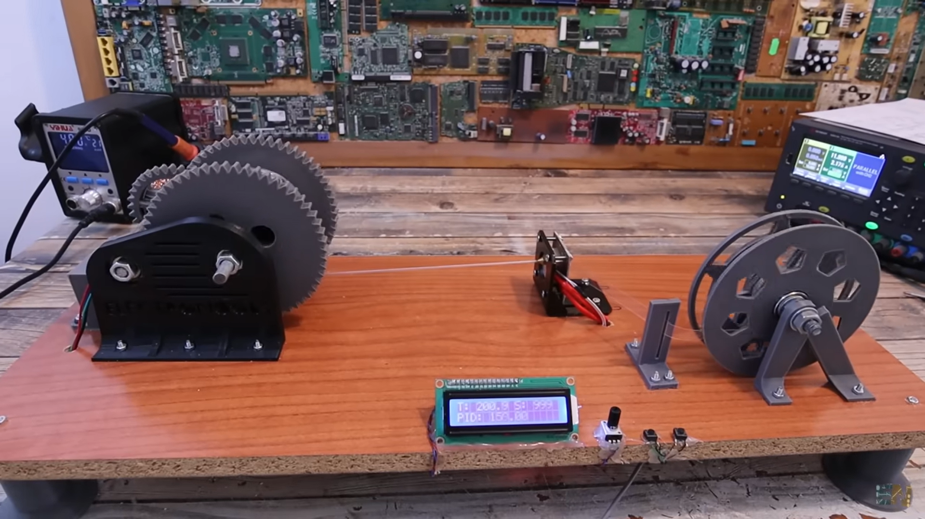
How it works
3D fila
Trash to Treasure

Slide 6
Target market
For engineering hubs and product developers
Who are dissatisfied with the high cost of filaments and the effort spent on maintaining them
Our product is a 3D filament-making device
That provides the ability to produce filaments at a lower cost
Unlike available products that are expensive and difficult to maintain.
3D fila
Trash to Treasure

Slide 7
Market size
We are targeting schools, workshop, innovation spaces, and individuals who are in Rapid prototyping industry.
TAM
FRW 250 million annually
SAM
FRW 160 million annually
SOM
10% of serviceable market
About FRW 16 million
3D fila
Trash to Treasure

Slide 8
Product traction
Current stage
We are on the MVP stage, with a working prototype that recycles PET plastic into 3D printing filament, and beta users providing valuable feedback.
Customer base
The product is currently being used by small businesses and individuals. Our early traction includes generating revenue from these initial users validating our business model.
Growth potential
We’ve raised FRW 1.7 million from early users and supporters, showing strong market interest, with significant expansion potential as demand for 3D printing materials grows.
3D fila
Trash to Treasure

Slide 9
Business model
PRODUCTS | Cost of Production (FRW) | Selling Price (FRW) | Profit per Unit (FRW)
Filament Making Machine | 115,000 | 220,000 | 105,000
Recycled 3D printing filament | 6,200 | 10,000 | 4,800
3D fila
Trash to Treasure

Slide 10
Competition
 | 3D FILA | POLYFORMER | PETAMENTOR | PROTOCYCLER
LOCAL PRODUCTION | ☑ | ⮽ | ⮽ | ⮽
USER-FRIENDLY | ☑ | ☑ | ⮽ | ⮽
SUSTAINABILITY | ☑ | ☑ | ☑ | ☑
3D fila
Trash to Treasure

Slide 11
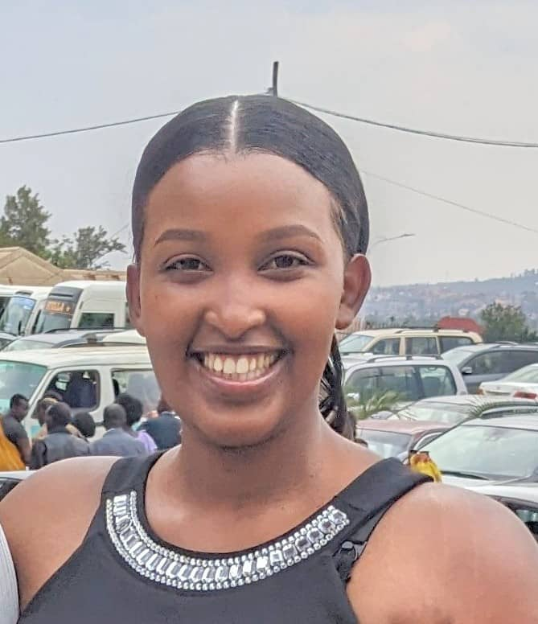
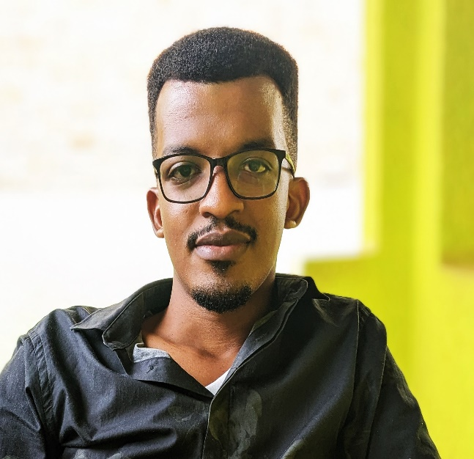
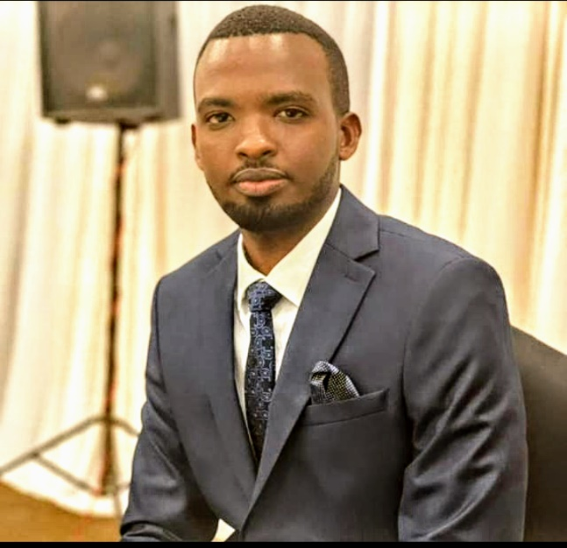
Team
MUHIRE ALPHONSE
FOUNDER
Bachelor in Mechanical engineer
MBABAZI ERIC
C.T.O
Bachelor in business administration
MUCYO EDITH
C.F.O
Masters in Quantitative economics
3D fila
Trash to Treasure

Slide 12

Take an action by joining us in recycling plastics today and build a greener future by turning plastic waste into valuable 3D filament.
THANK YOU
3D fila
Trash to Treasure

